Slide 1
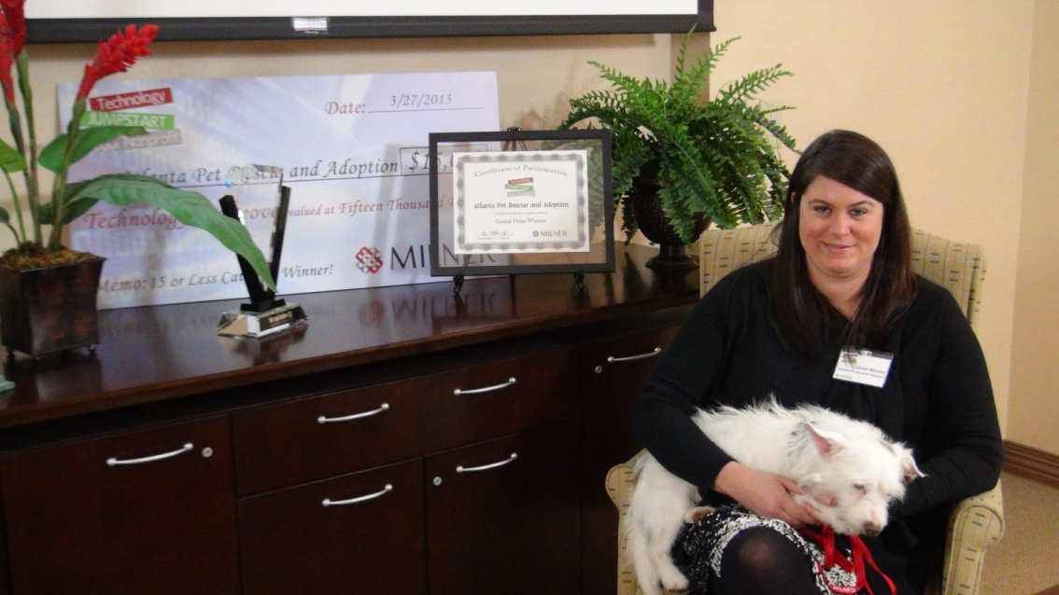
2014 MEDIA KIT
www.milner.com/jumpstart

Slide 2
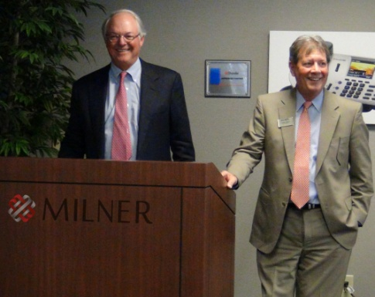
EXECUTIVE SUMMARY
Making a Difference.
Milner Inc., a full service provider of business‐to‐business solutions in the document imaging and office technologies, is offering nonprofit organizations in the Raleigh-Durham, NC area a chance to enter and win the “Technology JumpStart your Nonprofit” contest.
With all the challenges involved in running nonprofit organizations, finding the time and available funds to manage and improve office technologies are often difficult. This contest is our opportunity to say “thank you” for touching lives and making a difference within the community .
Two winning organizations, will receive an office equipment makeover, with a combined total value up to $35,000. The makeover may include, but is not limited to: a black & white and/or color multifunction printer, telephony equipment, IT Consulting Services, ongoing networking support, and other technologies to make your office run more efficiently.
Milner completed a JumpStart program in the metro Atlanta area earlier this year. The overwhelming response resulted in 109 organizations being nominated and over 60,000 online votes being cast.
Registration launches in October 2013 followed by two phases of voting. The winners will be announced at an award ceremony in February 2014.
Your participation as a valued sponsor will significantly support this contest, its mission and will exhibit your appreciation and gratitude within the local community and surrounding areas.
“This is our way of thanking nonprofit organizations for the work they do in providing charitable services in our communities.” said Charlie Gibson, Vice President of Milner, Inc. “This contest enables us to give back to the communities in which we do business – an endeavor for which we are very proud.”
Gene Milner, Jr., President, and Charlie Gibson, EVP of Milner, Inc.

Slide 3
www.milner.com/jumpstart
MEDIA
Community Coverage.
In addition to marketing this contest through social media, we also engage media outlets such as local TV news stations, newspapers, online blogs, and radio. This is another way to expand our marketing strategy for maximum visibility.
Video.
For our Atlanta media coverage, we had a representative from each of the top ten finalist appear on WXIA’s Atlanta & Company, allowing additional exposure for the nonprofits of the community. It was broken into 5 segments, featuring 2 nonprofits per show.
Video 1
Video 2
Video 3
Print.
Expanding further, these are a few examples of other media outlets that covered the Milner Technology JumpStart Your Nonprofit contest:
Atlanta Day Book
Dallas-Hirem Patch
Atlanta Daily World
.
Web.
Many online press releases, blog and Facebook posts were published by the competing nonprofit organizations .
Ads.
Milner placed ads with the Atlanta Journal Constitution and the Atlanta Business Chronicle.
Press Releases.
Milner submitted press releases that were distributed across the Web to enhance publicity and recognition of the contest.

Slide 4
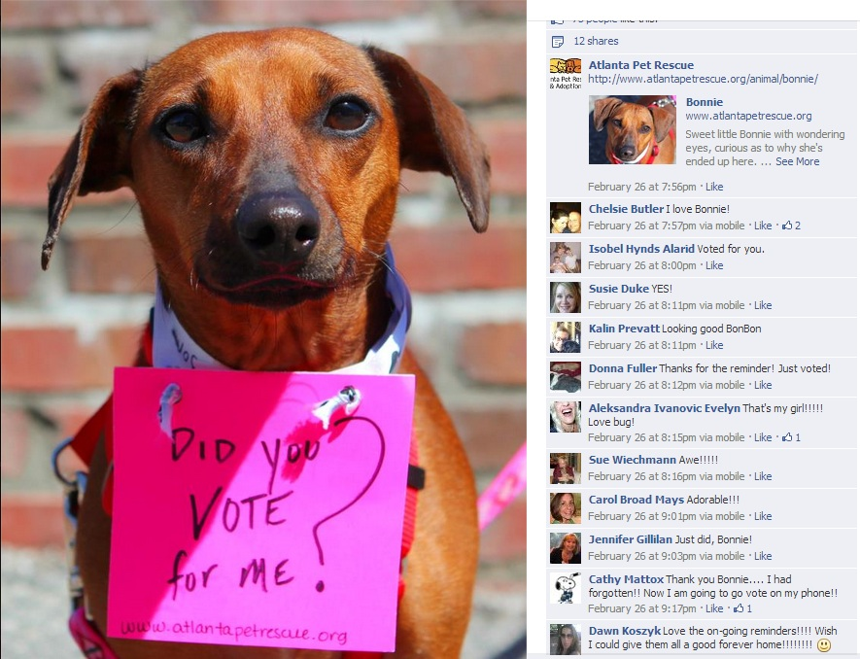
www.milner.com/jumpstart
Facebook post from Atlanta Pet Rescue and Adoption, final voting round
SOCIAL MEDIA
Keeping it Simple.
This contest is primarily driven via social media which adds simplicity for the nonprofits to get creative with daily posts on Facebook and Twitter. Asking for votes by their loyal community supporters gets everyone involved.
The nonprofits’ motivation helps spread the news of this contest which drives people to our website to vote. This enables a significant amount of people recognizing your partnership.

Slide 5
www.milner.com/jumpstart
Milner Annouces Winners of the “Technology JumpStart your Nonprofit” Contest
Two winning nonprofits receive office technology makeovers valued at $35,000
NORCROSS, GA -- Milner Inc., Atlanta’s largest independent provider of office solutions and technology services, has named the winners of the company sponsored “Technology JumpStart Your Nonprofit” contest to provide technology makeovers to two metro-Atlanta nonprofit groups.
After tallying over 80,000 online votes, the winning organizations are Atlanta Pet Rescue and Adoption, Smyrna, and Wellspring Living, Tyrone. APRSA and Wellspring were selected as based on public voting for a nonprofit with 15 or less employees and 16-plus employees, respectively.
Each winner, one from each voting category, will receive an office technology makeover designed to improve the efficiency of the nonprofit by enhancing its technological capabilities. Representatives from Milner will visit the offices of the winners to assess their current situation and tailor a makeover to fulfill their specific needs.
The makeovers, worth a combined program value of $35,000, may include, but is not limited to: networked black & white and/or color multifunction device, telephony equipment, IT consulting services, ongoing networking support, and other technologies.
Charlie Gibson, executive vice president of Milner, said, “Giving back to the organizations dedicated to serving our communities is something Milner feels privileged to do. The response was incredible. It’s obvious from the voting these organizations have some very passionate supporters.”
Over one hundred eligible submissions were received through December 2012 and public voting commenced on January 9, 2013 running through the 31st. The competing organizations enthusiastically spread the word and gained community support as a favorite nonprofit.
Six semi-finalists were selected based on the highest number of online votes, while the remaining four semi-finalists were selected by a Milner committee based on a 200-word essay submission on “why your nonprofit needs and office technology makeover.”
The top 10 finalists were notified and the final round of online voting ran from Feb. 11 - March 10. Each of the ten finalists were profiled on WXIA’s Atlanta & Company with the intent to provide additional exposure to the great organizations in our community.
The 10 finalists in the final round of voting were:
The Atlanta Children’s Shelter
The Atlanta Humane Society
Atlanta Pet Rescue and Adoption
The Atlanta Track Club
The Callanwolde Foundation
“We want to commend all of the participates and thank them for the work they do in our communities. For the remaining eight finalists, Milner will donate $500 in support of these wonderful organizations and their continuing efforts.” Gibson added.
Camp Twin Lakes
First Step Staffing
Rainbow Village
Second Life Thrift Store
Wellspring Living

Slide 6
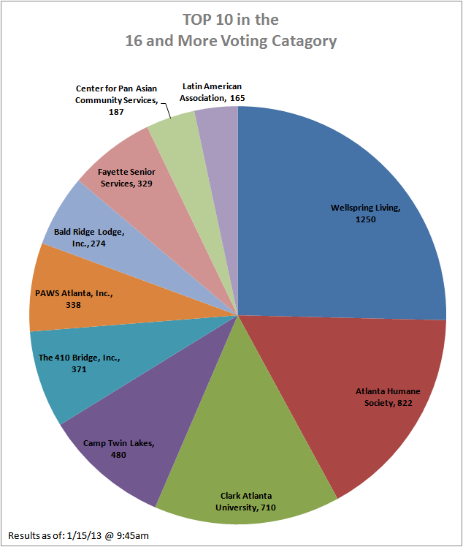
www.milner.com/jumpstart
CONTEST OUTLINE
Summary.
Two (2) organizations, one from each employment category will win a $20,000 AND a $15,000 Office Technology Makeover!
Milner, a business to business office solutions company in Raleigh, NC wants to give every 501(c)(3) nonprofit in the counties of Raleigh-Durham an opportunity to win an office technology makeover.
The only way to win is to submit an entry for the 2014 Milner Technology JumpSTART Your Nonprofit contest. Here’s how it works:
Complete the online entry form at www.milner.com/jumpstart or mail in the enclosed Registration Form by December 31, 2013 to be included in the Qualifying Round.
All eligible submissions will be posted online to allow the public to vote for their favorite organization beginning January 13, 2014. Tell your friends, volunteers and partners to vote for your organization at www.milner.com/jumpstart to be included in the top Final Round.
The top 10 finalist organizations will be announced and the Final Round of voting will begin February 3, 2014. Where the public will again have the opportunity to support your organization simply by voting.
Milner will announce the winning organizations the week of February 17, 2014. The winning organization from each voting group will receive an office technology makeover from $15,000 to $20,000.
Schedule.
Contact Nonprofits / Accept Nominations
August, September, October
Get community and business leaders involved to spread the word and to nominate nonprofits for participation.
Registration
October 28 – December 31, 2013 (30-days)
Nonprofits that wish to take part in the contest will complete the online entry form.
Participating Nonprofits Announced & Public Voting Begins
Round 1 Voting (January 13 – 26, 2014)
Round 2 – Final Round Voting (February 3 – 16, 2014)
- Top Ten Media Spotlights
- Video, Website coverage
Awards Ceremony
Breakfast and awards ceremony for all participates.
Voting Results, Final Round

Slide 7
www.milner.com/jumpstart
VISABILITY
Keeping it Simple.
A significant increase in website visits and social media pages (Facebook, Twitter and YouTube) proved our visibility and reach were successful.
Average visits to Milner.com during voting rounds.
“Not only are we going to get technology help, the JumpStart contest also really levered our fundraising arms. We received around 1,000 new Facebook “likes” during the campaign. We have also been all over Twitter and have new people signing up for our e-newsletter every day. It has been amazing because it has really helped us get our name out there, including us having a record week with adoptions.” – Grace Murphy, Atlanta Pet Rescue & Adoption
19,201
Average visits to Milner.com prior to contest.
8,349
“This program has helped us with our Facebook profile, which has been our main marketing tool since the beginning. Our normal average reach before this program, we were hitting maybe 3,000 people. During the peak of the voting phases, we were reaching almost 40,000 people.” – Toby Tobias SecondLife Thrift Store

Slide 8
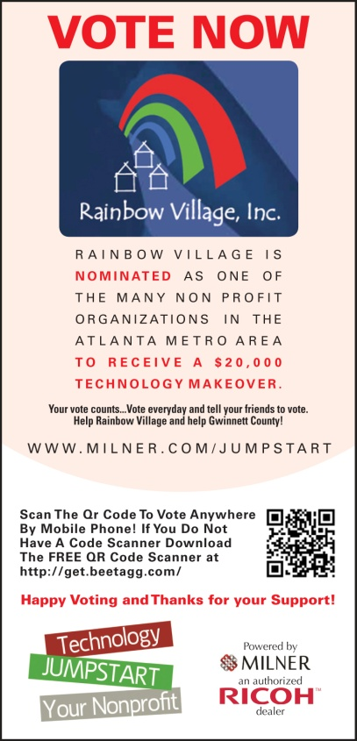
www.milner.com/jumpstart
SPONSORS / PARTNERS
Support your community.
Milner is looking for a select number of community partners and sponsors.
Exclusive Sponsorships Breakfast Sponsor – 2 available ($1,500)
Your company logo on the JumpStart voting webpage
Reciprocal website links
Logo on all award ceremony signage
3-minute recognition speech at award ceremony
Logo or name recognition in video credits
Awards Sponsor – 1 available ($1,000)
Your company logo on the JumpStart voting webpage
Reciprocal website links
Logo on all award ceremony signage
3-minute recognition speech at award ceremony
Logo or name recognition in video credits
Create Your Own Sponsorship – ($______ )
Submit an idea for your custom sponsorship including donation amount.
Non-Exclusive Partners
Media Partner
Your company logo on the JumpStart voting webpage
Reciprocal website links
Name recognition on all award ceremony signage
Community Partner
Your company logo on the JumpStart voting webpage
Reciprocal website links
Name recognition on all award ceremony signage

Slide 9
www.milner.com/jumpstart
SPONSOR SIGN UP FORM
Get Involved.
Organization:
Sponsorship Choice:
Name:
Phone:
Email:
Create Your Own Sponsorship Idea:
Sponsor Amount:
COMPLETE FORM & MAIL TO: Milner Inc. ATTN: Becky Wilkins, 5125 Peachtree Industrial Blvd Norcross, GA 30092 For questions, please contact Becky Wilkins at (770) 734-5307 or email bwilkins@milner.com.
Where applicable invoice will be sent.

Slide 10
JumpStart Team:
Media Contact:
Tristan Luciotti
Media Manager
E: tluciotti@milner.com
P: 770-734-5441
Local Contacts:
Noel Tucker Lori Byrd
Sales Director Marketing Coordinator
E: ntucker@milner.com E: lbyrd@milner.com
P: 919-781-5957 P: 919-781-5958
Milner, Inc.
Becky Wilkins
Marketing Director
5125 Peachtree Industrial Blvd
Norcross, GA 30092
www.milner.com
E: bwilkins@milner.com
P: 770-734-5307
F: 770-242-8270

